Slide 1
11.19.2019
Machine Learning In Azure
Kevin Ford
kevinf@magenic.com
617 359-5192

Slide 2
https://github.com/Magenic/MLTraining

Slide 3
CIMON – IBM AI in space

Slide 4
What is Artificial Intelligence?
“The theory and development of computer systems able to perform tasks normally requiring human intelligence, such as visual perception, speech recognition, decision-making, and translation between languages.” - Oxford Dictionary
Machine learning is the part of AI that deals with programs that can self improve or “learn”.

Slide 5
Challenges & Weaknesses of AI
Require huge amounts of clean, accurate & contextual data
Tend to be task specific
Require lots of domain specific knowledge
Cannot handle nuance & causation
Black box

Slide 6
Are these the same?
Artificial Intelligence
Machine Learning
Bot
Notes:
Artificial Intelligence – doing tasks that normally require human intelligence
Machine learning – subset of AI – comparing large sets of data to find patterns and make educated guesses based on those patterns
Bot – automate predefined tasks

Slide 7
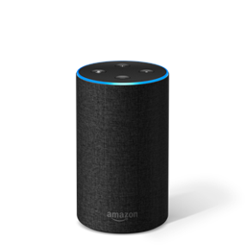
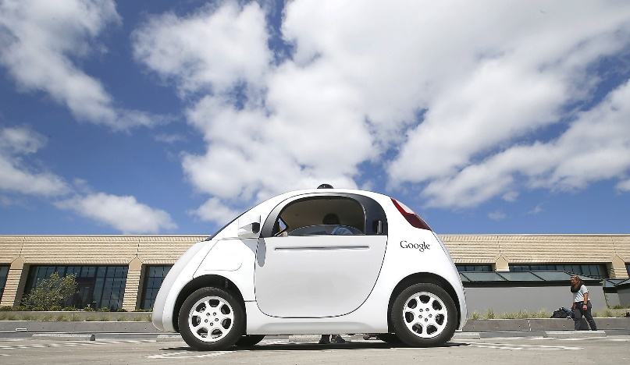
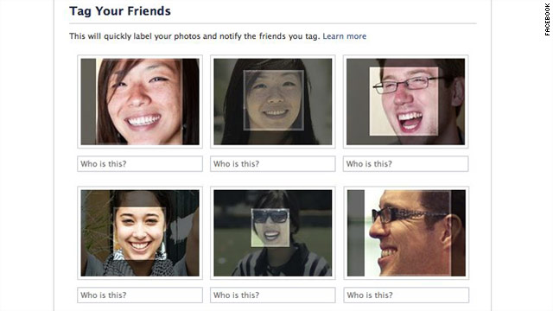

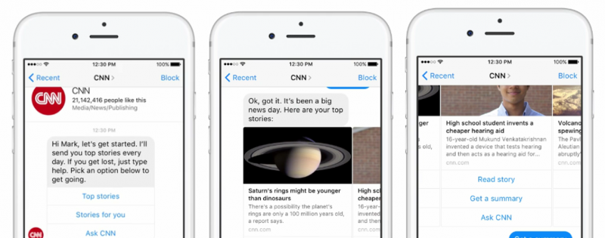
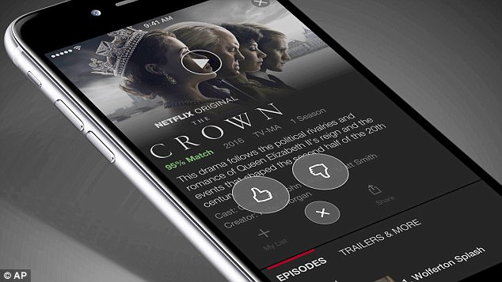
What is it being used for?
Smart personal assistants
Self-driving cars
Social media image recognition
Predictive stock trading
Entertainment
Chatbots

Slide 8
Key Terms
Feature Extraction
Classification
Neural Networks
Reinforcement Learning
Model
Notes:
Feature Extraction – Looking at raw data and pulling out items that may be used to recognize key features about that data that are relevant to understand it. With normal machine learning this is a manual process
Classification – This is where the magic happens. This is where a variety of statistical algorithms run and use the extracted features in different ways to attempt to answer questions about new and similar data that comes in.
Neural Networks – Networks that are designed to work like the human brain. The foundation of deep learning.
Reinforcement learning. – learning by trial and error the best ways to solve a problem
Model – is the product of feature extraction and classification. It can now be used to take newly input data and understand what it is based on the feature extraction and classification of data that has happened before. Reinforcement leaning can be used to improve the model over time.

Slide 9

Feature Extraction
Classification
Prediction
Model
Reinforcement Learning
Data Pre-Processing
Training a Model
Real World Results
Raw Data
Manual Process
The Magic
Training Data
Scoring Data

Slide 10
Feature Extraction
Classification
Prediction
Model
Reinforcement Learning
Data Pre-Processing
Deep Learning
Machine Learning
Real World Results
Raw Data
Manual Process
The Magic
The Magic
Training Data
Scoring Data

Slide 11
Machine Learning
Deep Learning
Requires human understanding of the data
More human effort
Requires more data
Requires more CPU power
Looks at data in unusual ways (Neural Network)
More of a black box

Slide 12
Server-Side Machine Learning Process
Server Side
Feature Extraction
Classification
Application
Prediction
Request
Web Service
Model
Answer
Answer Evaluation Reinforcement Learning

Slide 13
Client-Side Machine Learning Process
Server Side
Feature Extraction
Classification
Application
Prediction
Requests / Answers
Answer Evaluation Reinforcement Learning
Web Service
Model Creation / Updates
Copy of
Model
Updated
Model

Slide 14
Server-Side
Client-Side
Lots of data and CPU power
Full ecosystem
All clients use updated models
Platform agnostic
Works offline
Quick and local evaluation of inputs
No transaction cost

Slide 15
Required ML Skills for Developers
Coding skills still required to interface with APIs
Understanding of data and how it works
Basic math and statistics skills
Know the algorithms and capabilities that are available
Notes:
Coding still required but you are accessing an API versus writing the logic to solve the problem. i.e. passing it a data model and getting back an answer or prediction.
Basic understanding of data and how it works.
Basic math and stats skills

Slide 16
Prepare for Ambiguity
41.23% Cat
43.3% Cat
35.41% Octopus
35.2% Octopus
23.36% Superman
21.5% Superman

Slide 17
Machine Learning Frameworks
Notes:
Tensorflow – Backed by google, focuses on deep learning
Keras – open source framework neural network API
SCIKit-Learn – open source framework- started as a google summer of code project
Caffe - Berkeley AI Research project, now open source
Caffe2 – backed by Facebook, derived from Caffe,

Slide 18
Some Server-Side Machine Learning Cloud Providers
Notes:
IBM Watson
Azure Machine Learning
AWS Machine Learning
SAP Leonardo
Google Cloud Machine Learning Engine / Tensorflow
BigML

Slide 19
Not All ML Tools are Easy

Slide 20











Starting with Azure Cognitive Services
Canned models that do specific things
Some can be trained
Some can work client side
Notes:
Computer Vision
Speech
Text Analysis
Face
Translate Text
Custom Vision
Content Moderator
Speaker Recognition
Ink recognizer
Speech
QnA Maker
Anomaly Detector

Slide 21
Custom Vision
Allows training of custom models for image recognition
Why would I want to do this
Evaluation of an XRay
Finding a defect in a manufactured product
Identifying a part on an HAVAC unit

Slide 22
Demo 1: Training a Custom Vision Model

Slide 23
Lab 1: Creating a Custom Vision model (25 minutes)

Slide 24
Demo 2: Using a Custom Vision Model

Slide 25
Lab 2: Deploying and calling Custom Vision Service / Reinforcement Learning (30 minutes)

Slide 26
Conversational UIs - Text

Slide 27
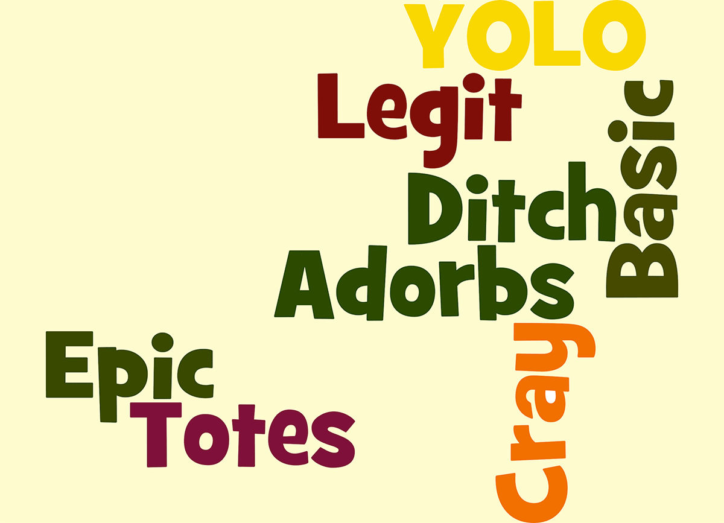
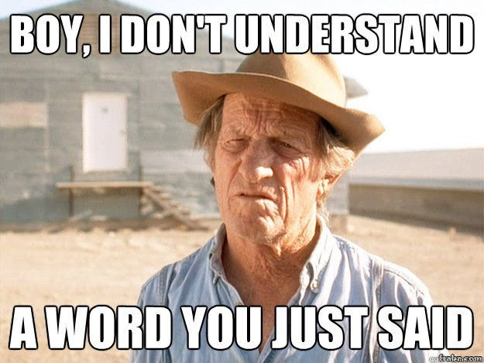
When to use language understanding?
Not a guided process but perhaps a selector for what they want to do
Simple interactions that can be expressed in multiple ways – Complex interactions? Use a Bot
When the same types of actions need to happen to different things
When interacting with a traditional data entry screen isn’t optimal
When you understand how your audience communicates

Slide 28

Simple Model Using Azure Luis
User entered text
Evaluation of entered text
Application Logic

Slide 29

Key Concepts
Entity
Intent
App -> Model
Training
Utterance
Role
Notes:
Entity – a list of replaceable elements that tell you something about what is being asked for
Intent – the type of interaction the user wants I want a new project
App – A collection of entities, intents and other items used to create a domain specific model
Training – the process of ensuring that the understanding of the conversation is what you expect
Utterance – input from the user that the app will interpret
Roles – How an entity is being used in an utterance. For example is a city a start location or destination?

Slide 30
LUIS Model Development
https://www.luis.ai/applications
Feature Extraction
Classification
Prediction
Plan
Setup Intents and Entities
Train
Test
Publish
Prebuilt Domains
Model

Slide 31

Bots and natural language
Used when there is an asymmetric flow
Understand user’s intent
Get off my lawn!
Nature Language
Not a certain as a guided flow
Intent
Bot
Can be used to determine what to do next
Can be called directly from the bot

Slide 32
Demo 3: Setting up a LUIS Model

Slide 33
Lab 3: Setting up the LUIS service (30 Minutes)

Slide 34
Communicating with LUIS
User entered text
REST API
Evaluation of entered text
{Azure Service URL}?subscription-key={Key}&timezoneOffset=-360&q={user’s text}
Application Logic
JSON Response

Slide 35
Expanding Our Simple Model
What does the user want to do?
Intent
Create a bug
Change a bug’s status
Close a bug

Slide 36
Outside of Our Custom App
Channels
Multi-Purpose Bot
Create a bug
Change a bug’s status
Close a bug

Slide 37
Lab 4: Calling into our LUIS service (20 minutes)

Slide 38
Anomaly Detector (Preview)
Finds anomalies given data in a time series
Uses a Spectral Residual
Three different things to use it for
Is the latest point in a series an anomaly? (Real time monitoring)
Evaluate all points, check if all points in a range (Historical analysis)
Does a specific point signify a change? (REST ) (When did things go awry?)

Slide 39
How does it Work?
Spectral Residual

Slide 40
Anomaly Detector Advantages / Usages
Unsupervised Learning
Takes almost any time/numeric pairs regardless of nature of series
Low time/CPU results
>

Slide 41
Lab 5: Using the Anomaly Detector (25 minutes)

Slide 42
Machine Learning Studio
Create truly custom models
Somewhat easy to use
Here is where knowledge of statistics really comes into play
Can Take substantial compute time to create models

Slide 43
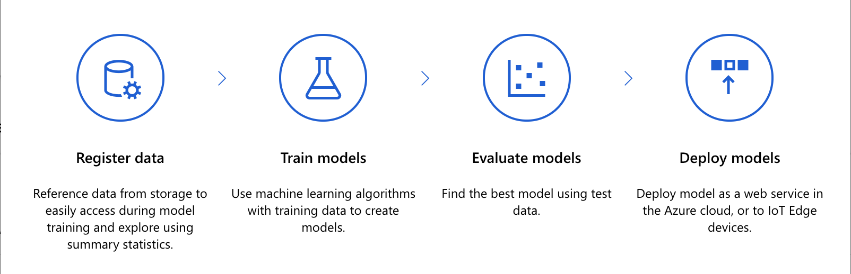
Machine Learning Studio

Slide 44
Machine Learning Studio Authoring tools
Notebooks
Automated ML
Designer

Slide 45
Machine Learning Studio Assets
Dataset
Experiment
Pipeline
Model
Endpoint
Realtime
Pipeline
Notes:
Dataset – datasets that can be imported and used in our work
Experiment – A setup of how to apply functions to the data to create a model
Pipeline - an independently executable workflow of a complete machine learning task - Like a history of runs with results
Model -

Slide 46
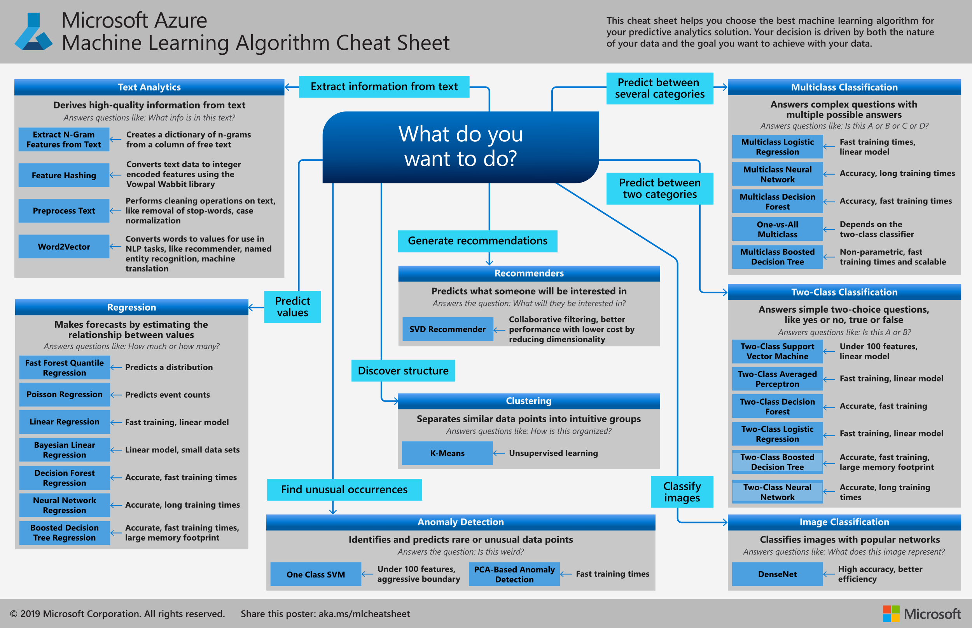

Slide 47
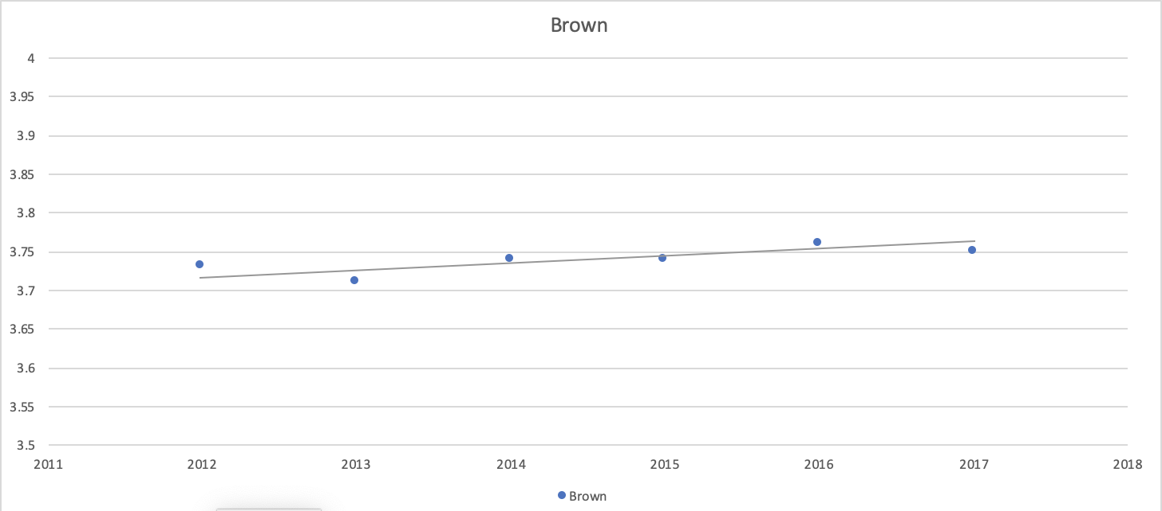
Direct Statistical Models - Linear Regression
y = mx + b

Slide 48
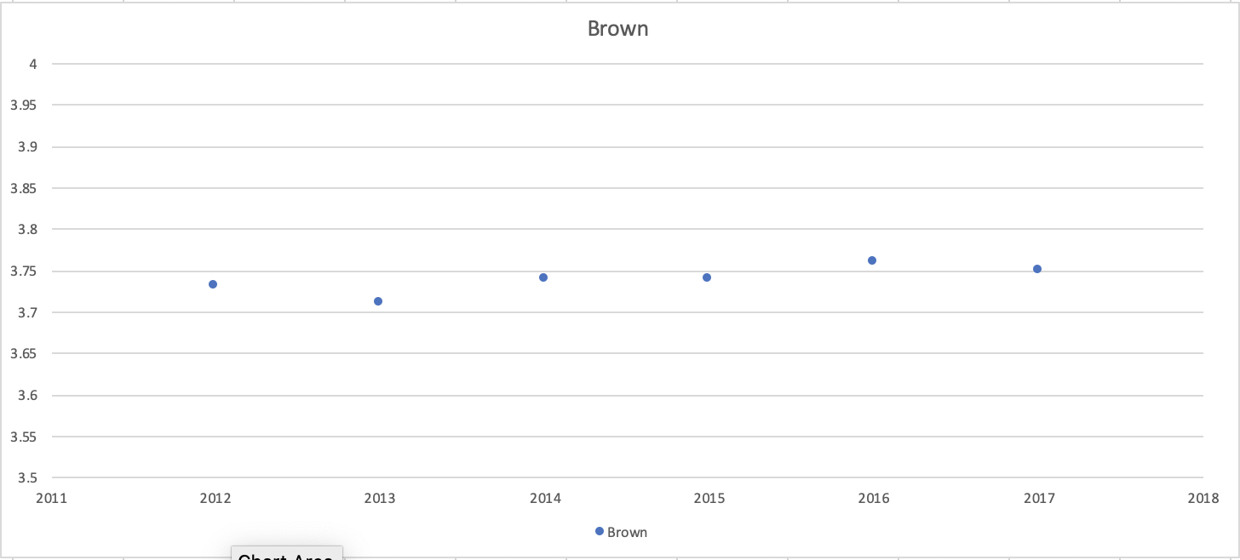
How is this figured out?

Slide 49
How about this point?
Standard Deviation

Slide 50
Demo 3: Creating a Custom Model using Azure Machine Learning Studio

Slide 51
Lab 6: Using Azure Machine Learning Studio (35 minutes)

Slide 52
Q & A

